Slide 1
Distributed Builds

Slide 2
What are distributed builds?
Distributed builds are builds run on nodes other than the master node.
Master
Serves HTTP requests
Stores all important info
Slaves
170KB single jar
Assumed to be unreliable
Scale to at least 100
Distributed build architecture is a Jenkins best practice.

Slide 3
What are distributed builds?
Slave agent is a small Java program
Runs locally on the machine that it controls
Access files, fork processes, etc., on behalf of master
Communication with master
Needs a bi-directional byte stream
Very flexible in how this gets set up
No shared file system, no network topology constraints, etc

Slide 4
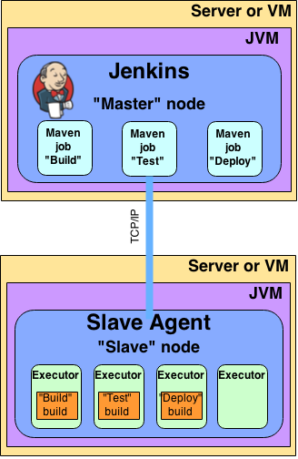
What are distributed builds?

Slide 5
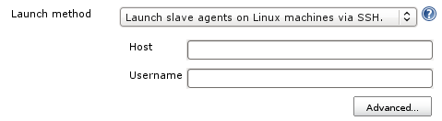
What are distributed builds?
Communication between Jenkins and Unix slaves can be via SSH
Only need SSHD on slaves
Java installed for you
Just need a host name and credentials to connect

Slide 6
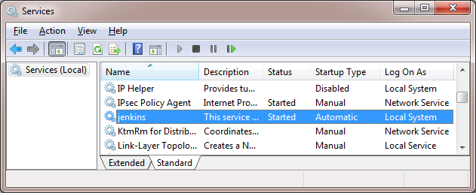
What are distributed builds?
To connect Jenkins to Windows slave, DCOM is an option
Just need admin user name and password
No manual intervention
Works even from Unix masters

Slide 7

What are distributed builds?
To connect Jenkins to Windows slave or a slave in another data center, Java Web Start is another option
For cases when the master cannot “see” slaves
A separate socket connection is made
Once started, can be installed as a service
Can also be run headlessly via jar

Slide 8
Benefits: scalability
Masters can use resources to orchestrate, allowing one master to orchestrate 100s to 1,000s of builds a day.
Scaling when build demand increases will only involve pointing Jenkins at another slave node, rather than creating an entirely new master from scratch.

Slide 9
Benefits: security
Jobs that run on a master have full permissions on all Jenkins resources on the master node, potentially allowing a malicious user to access private information from other builds or the system itself.
Running jobs on separate and isolated machines mitigates this risk.

Slide 10
Where do we start?
Slaves must be able to establish bi-directional communication with a master.
Slaves also need build tools installed to them to build your jobs.
It is a best practice to configure a job to assume that the target slave doesn’t have any tools install and make tool installation part of the build process.
Once slaves have been created, jobs can be configured to only run on slaves with specific label names.

